Slide 1
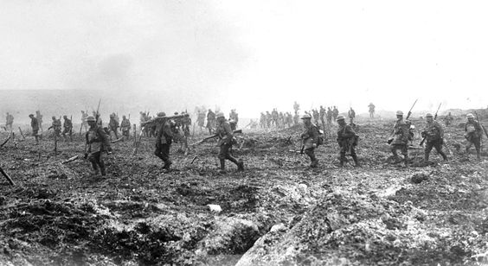
Bring the Battle of Vimy Ridge into Elementary Libraries and Classrooms
Sigmund Brouwer and John Wilson

Slide 2
The Battle of Vimy Ridge in Context
age appropriate history
a growing sense of Canadian nationhood
teaching the history of the First World War
the experience of Canadian soldiers at war

Slide 3
Internet Sources
http://www.warmuseum.ca/firstworldwar/
http://www.veterans.gc.ca/eng/remembrance/history/first-world-war
http://ww1.canada.com
http://www.thecanadianencyclopedia.ca/en/article/first-world-war-wwi/
https://www.collectionscanada.gc.ca/firstworldwar/index-e.html
http://www.thememoryproject.com/stories/WWI

Slide 4
Show and Tell

Slide 5
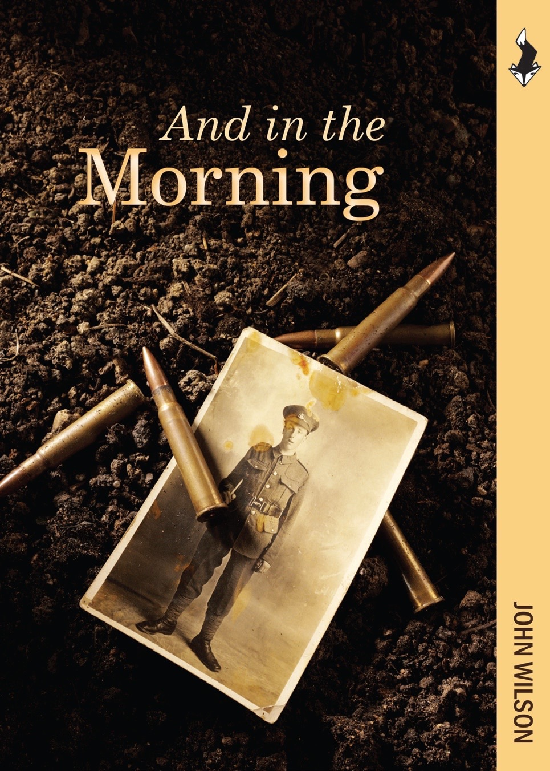
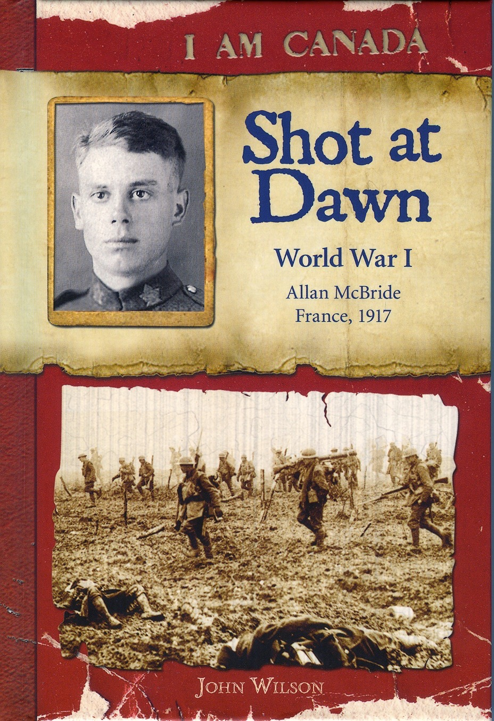

Slide 6
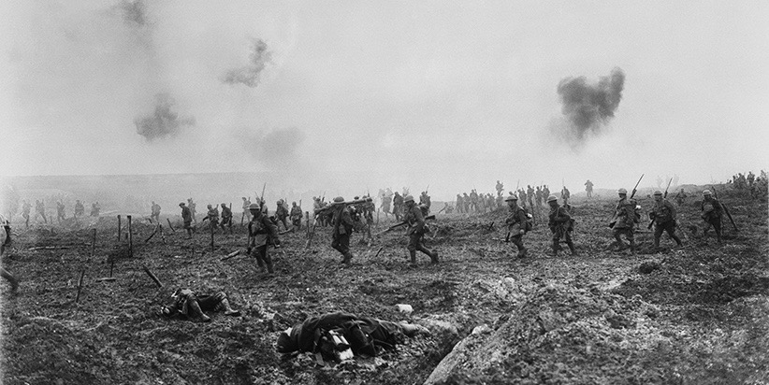

Slide 7
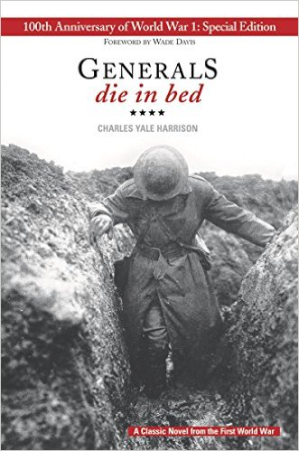

Slide 8
Memorialization

Slide 9
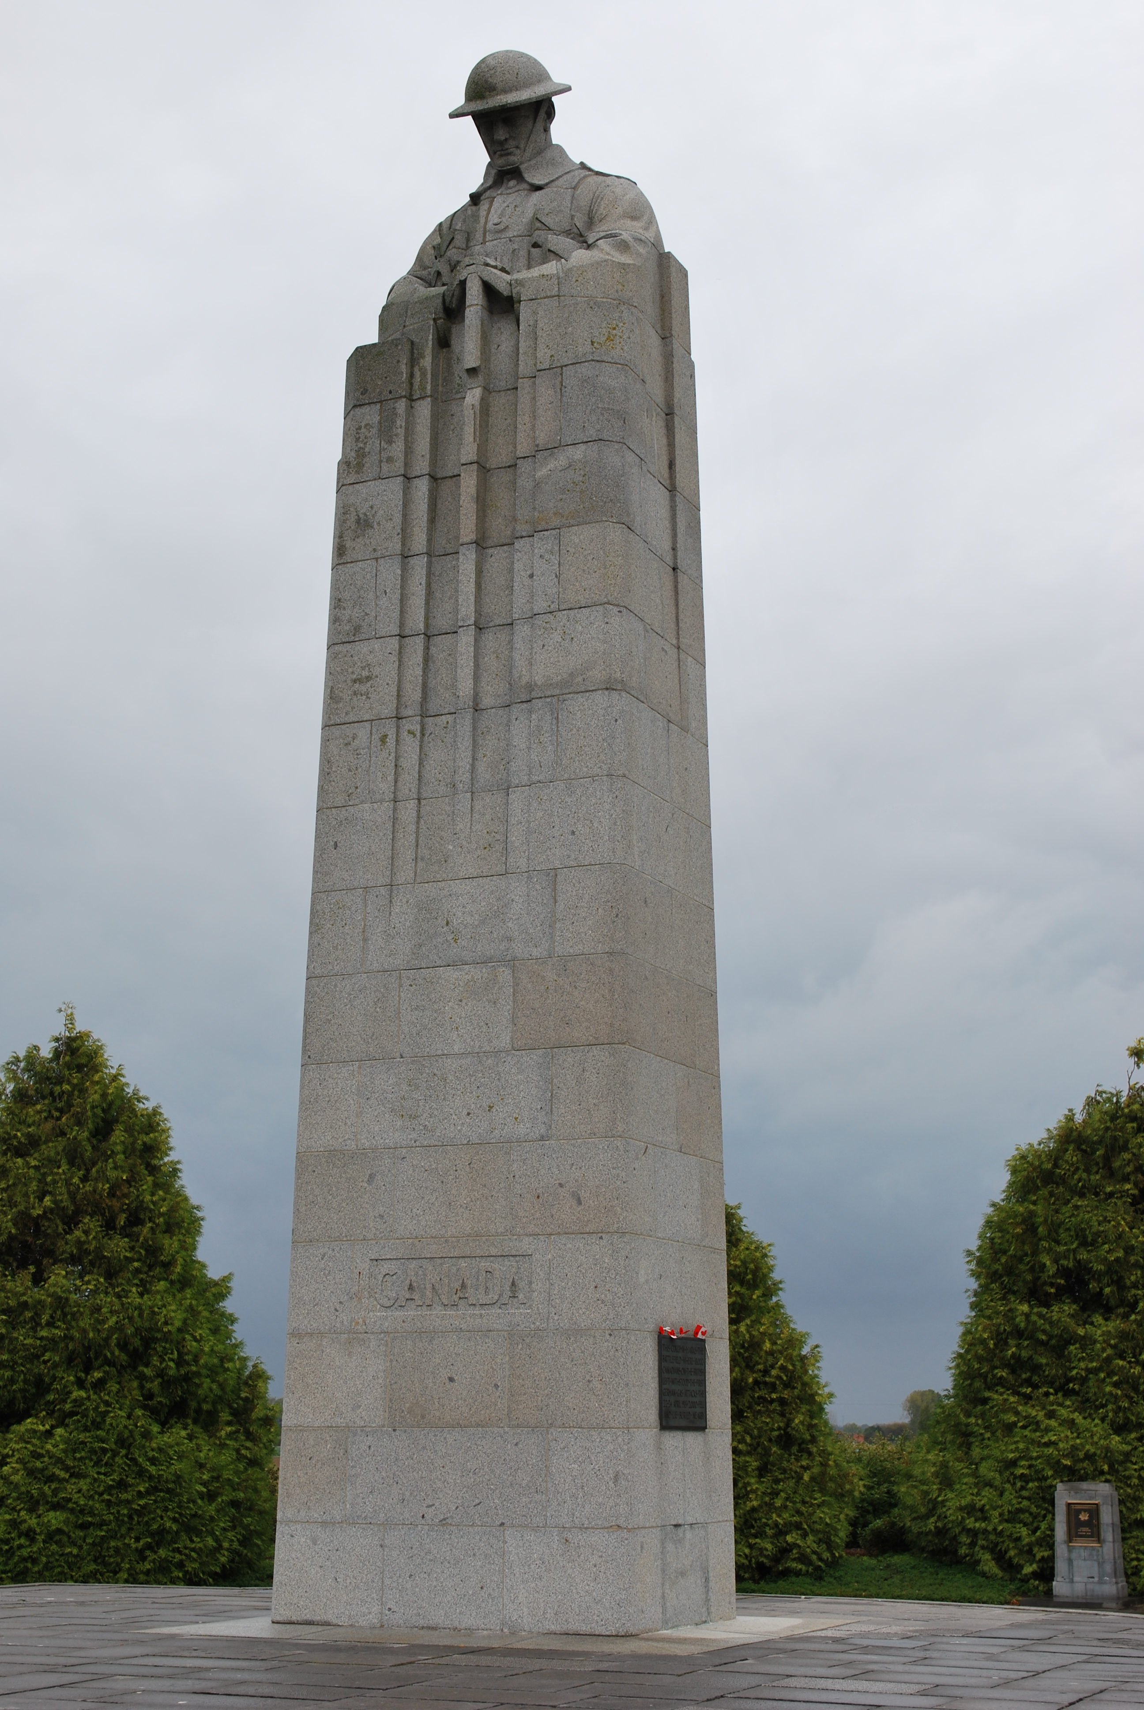

Slide 10
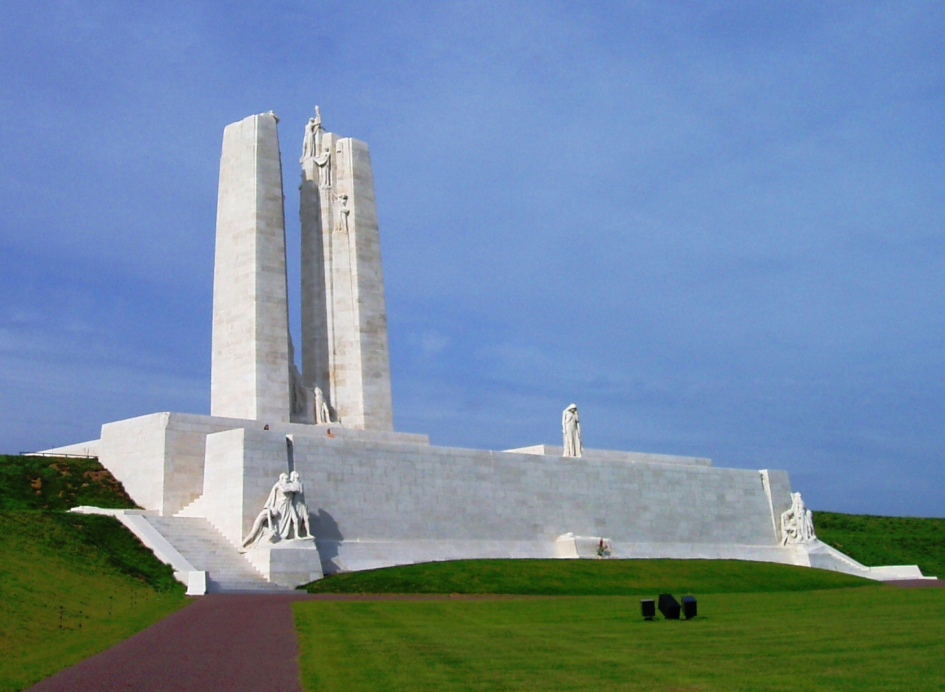

Slide 11
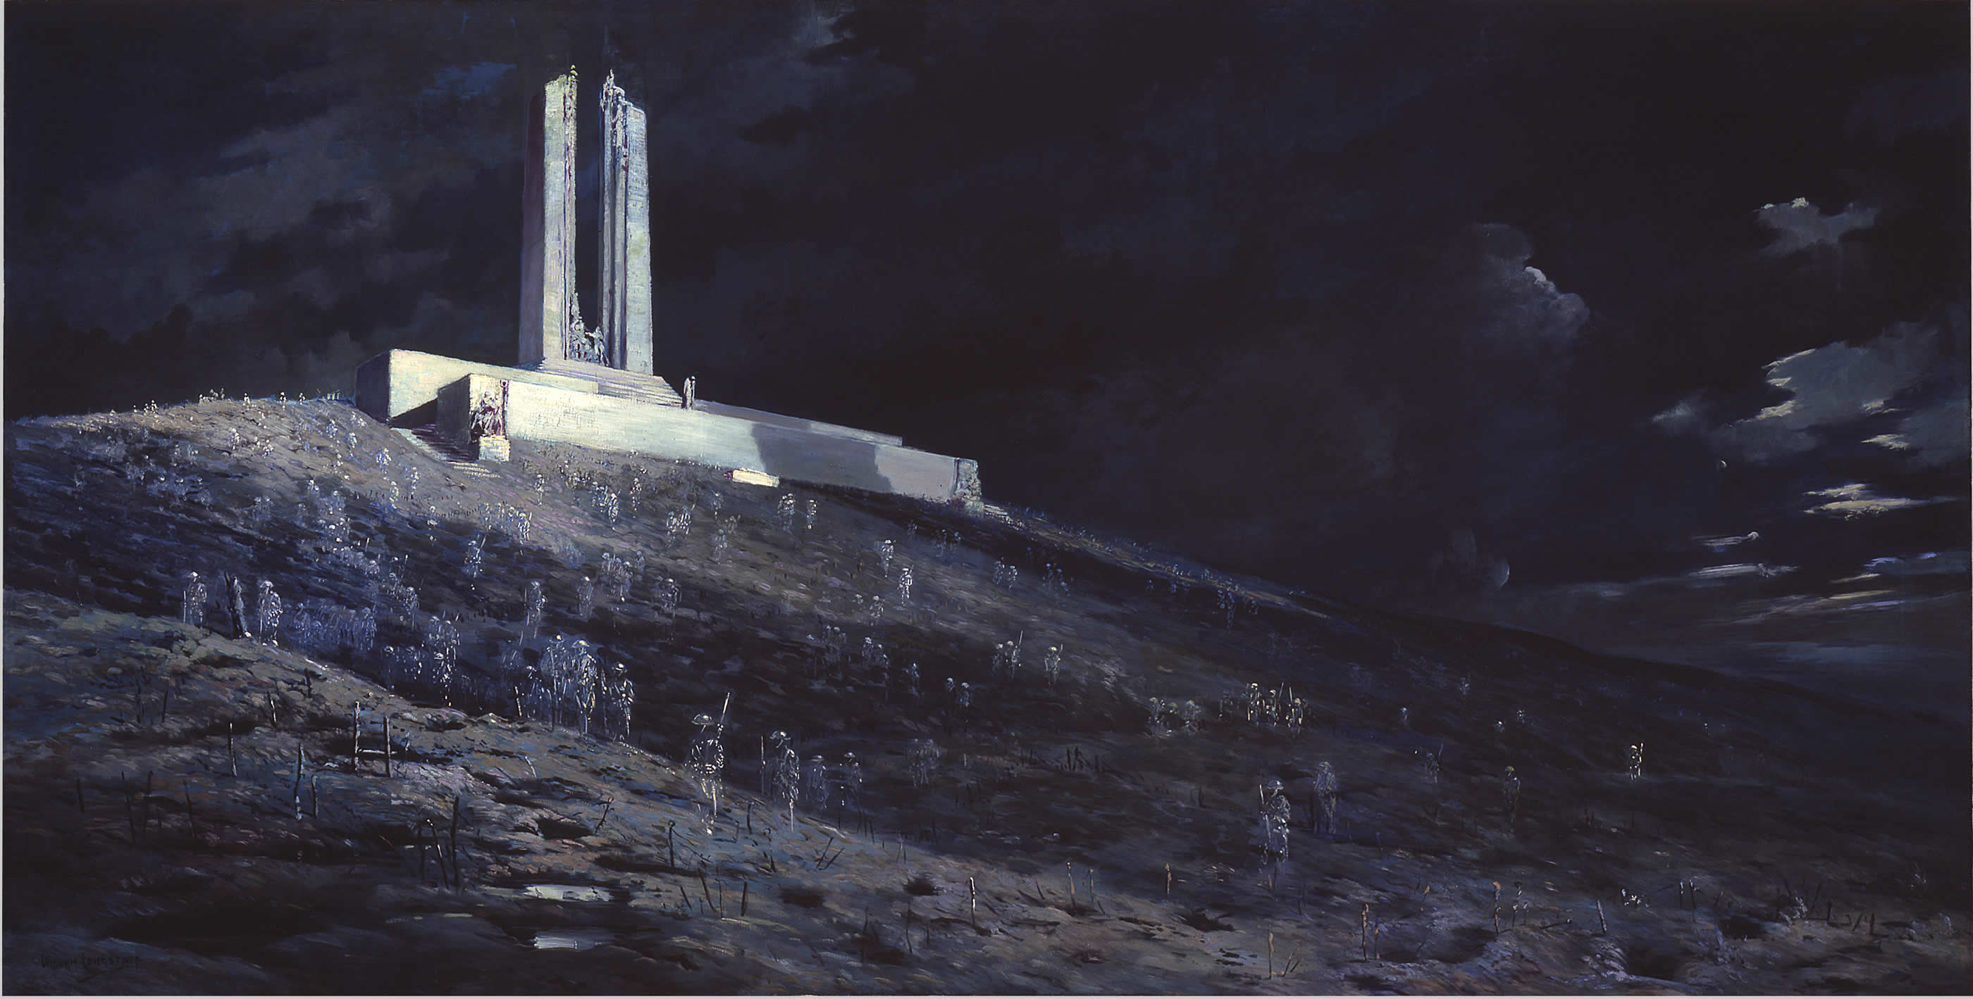

Slide 12
The map I promised not to Show!

Slide 13
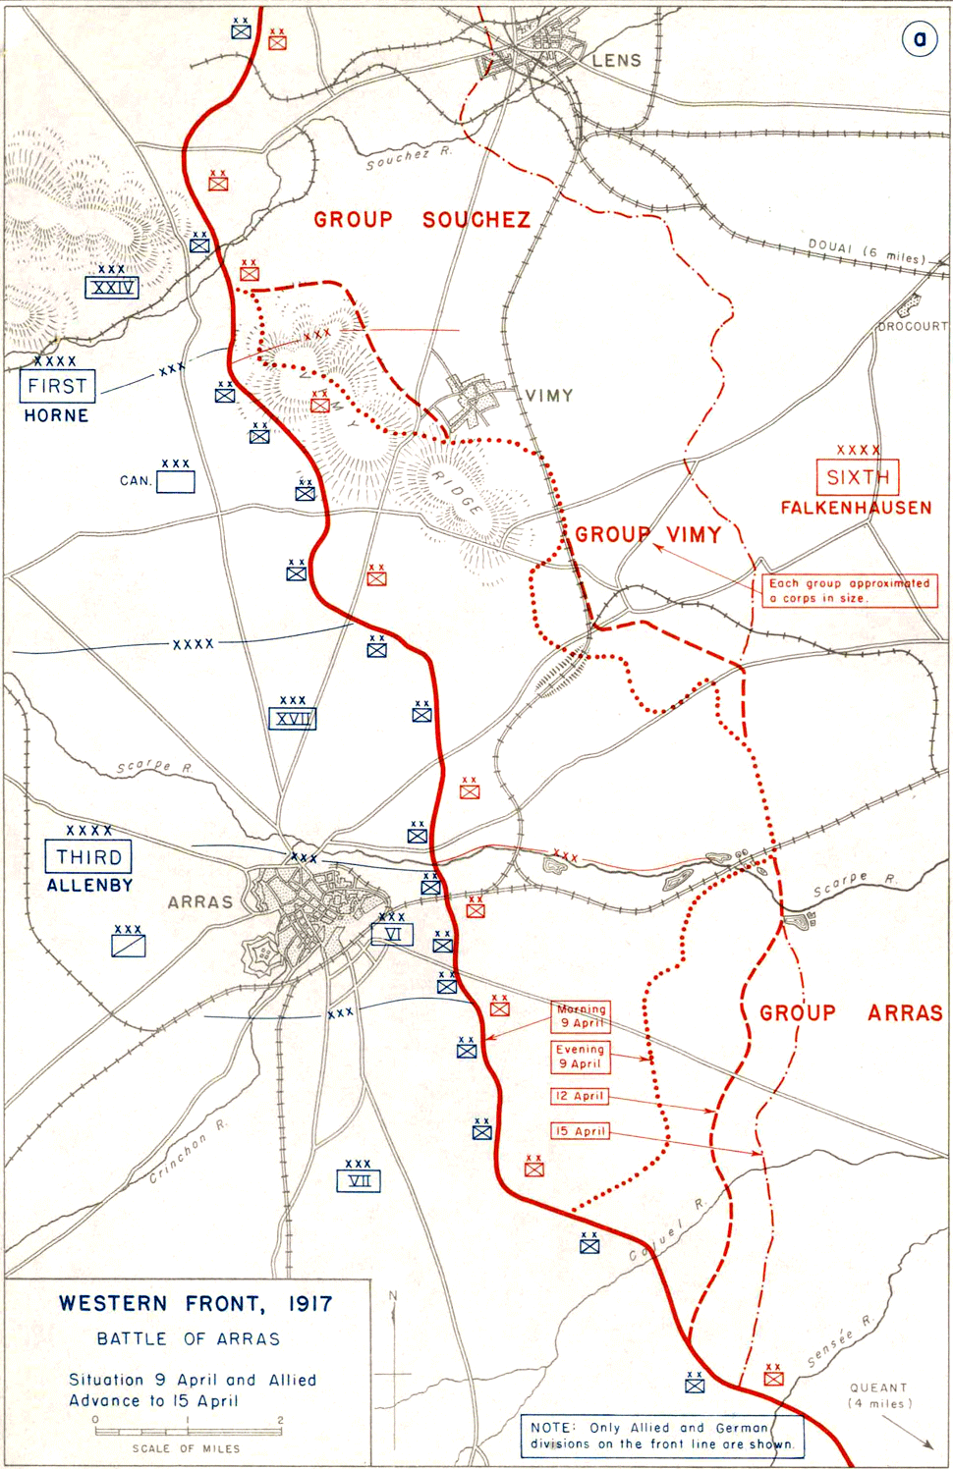
The Battle of Arras

Slide 14
Resources
Non-Fiction

Slide 16
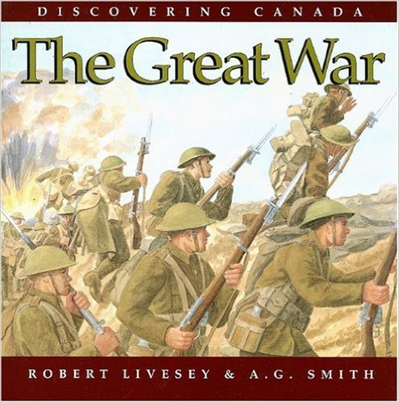
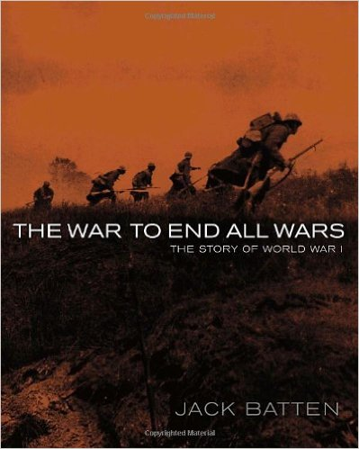
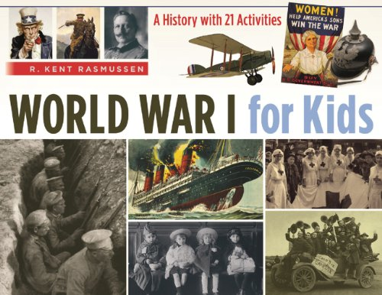
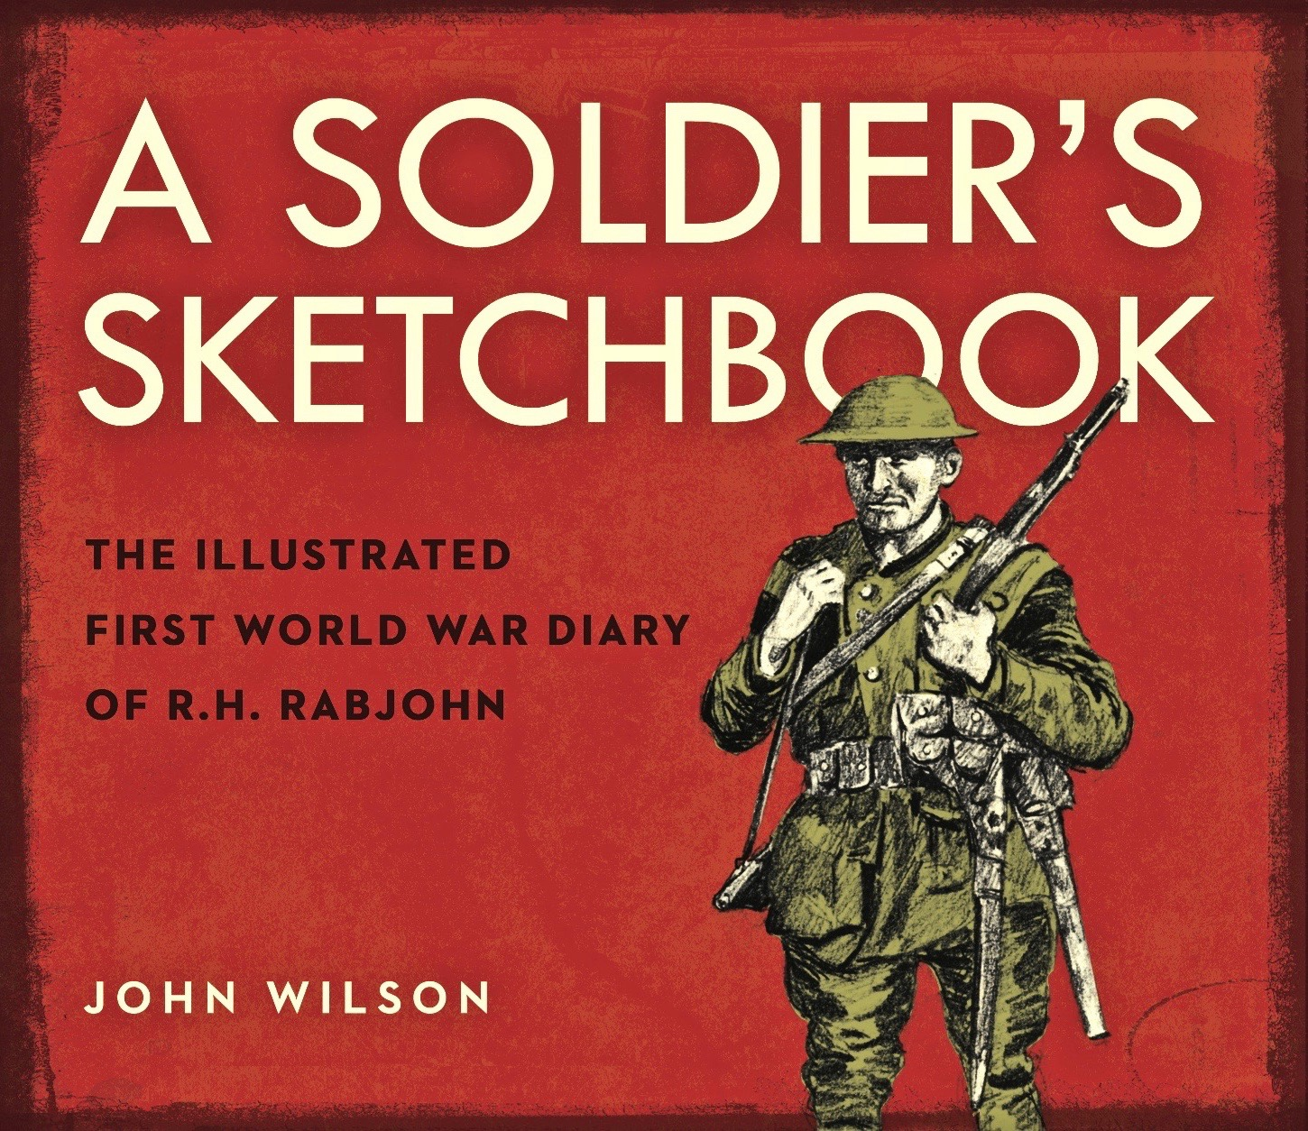

Slide 17
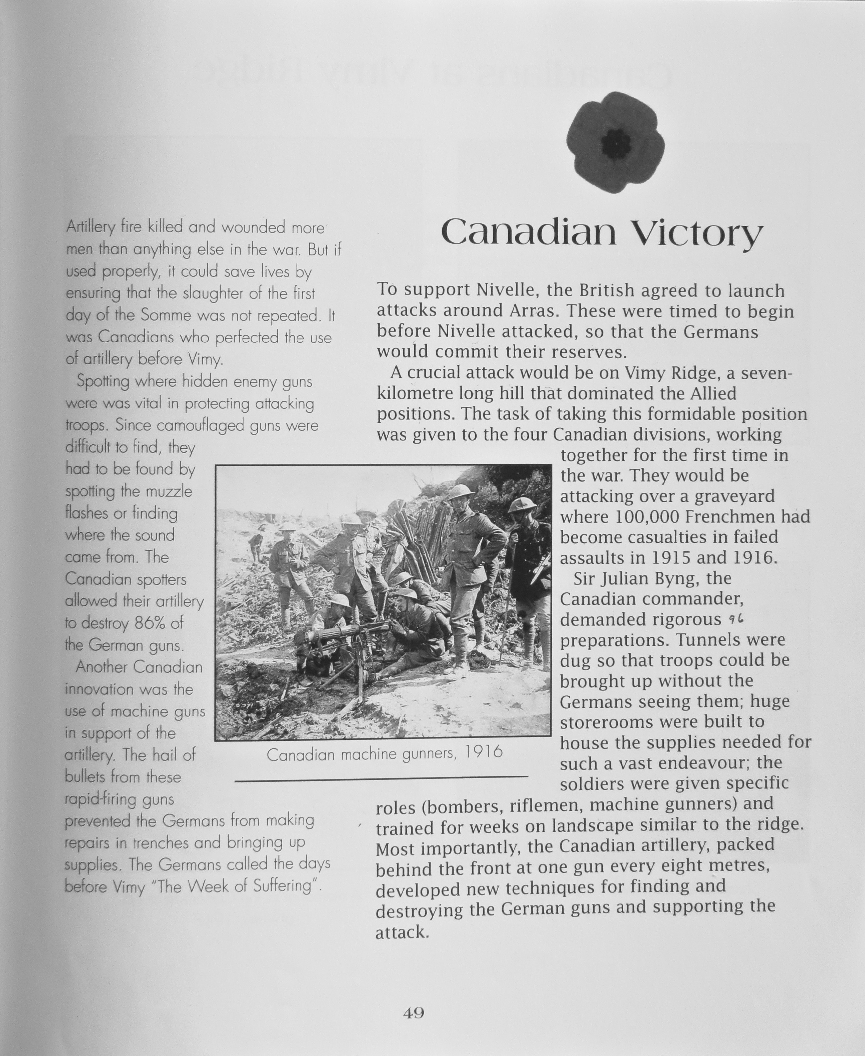
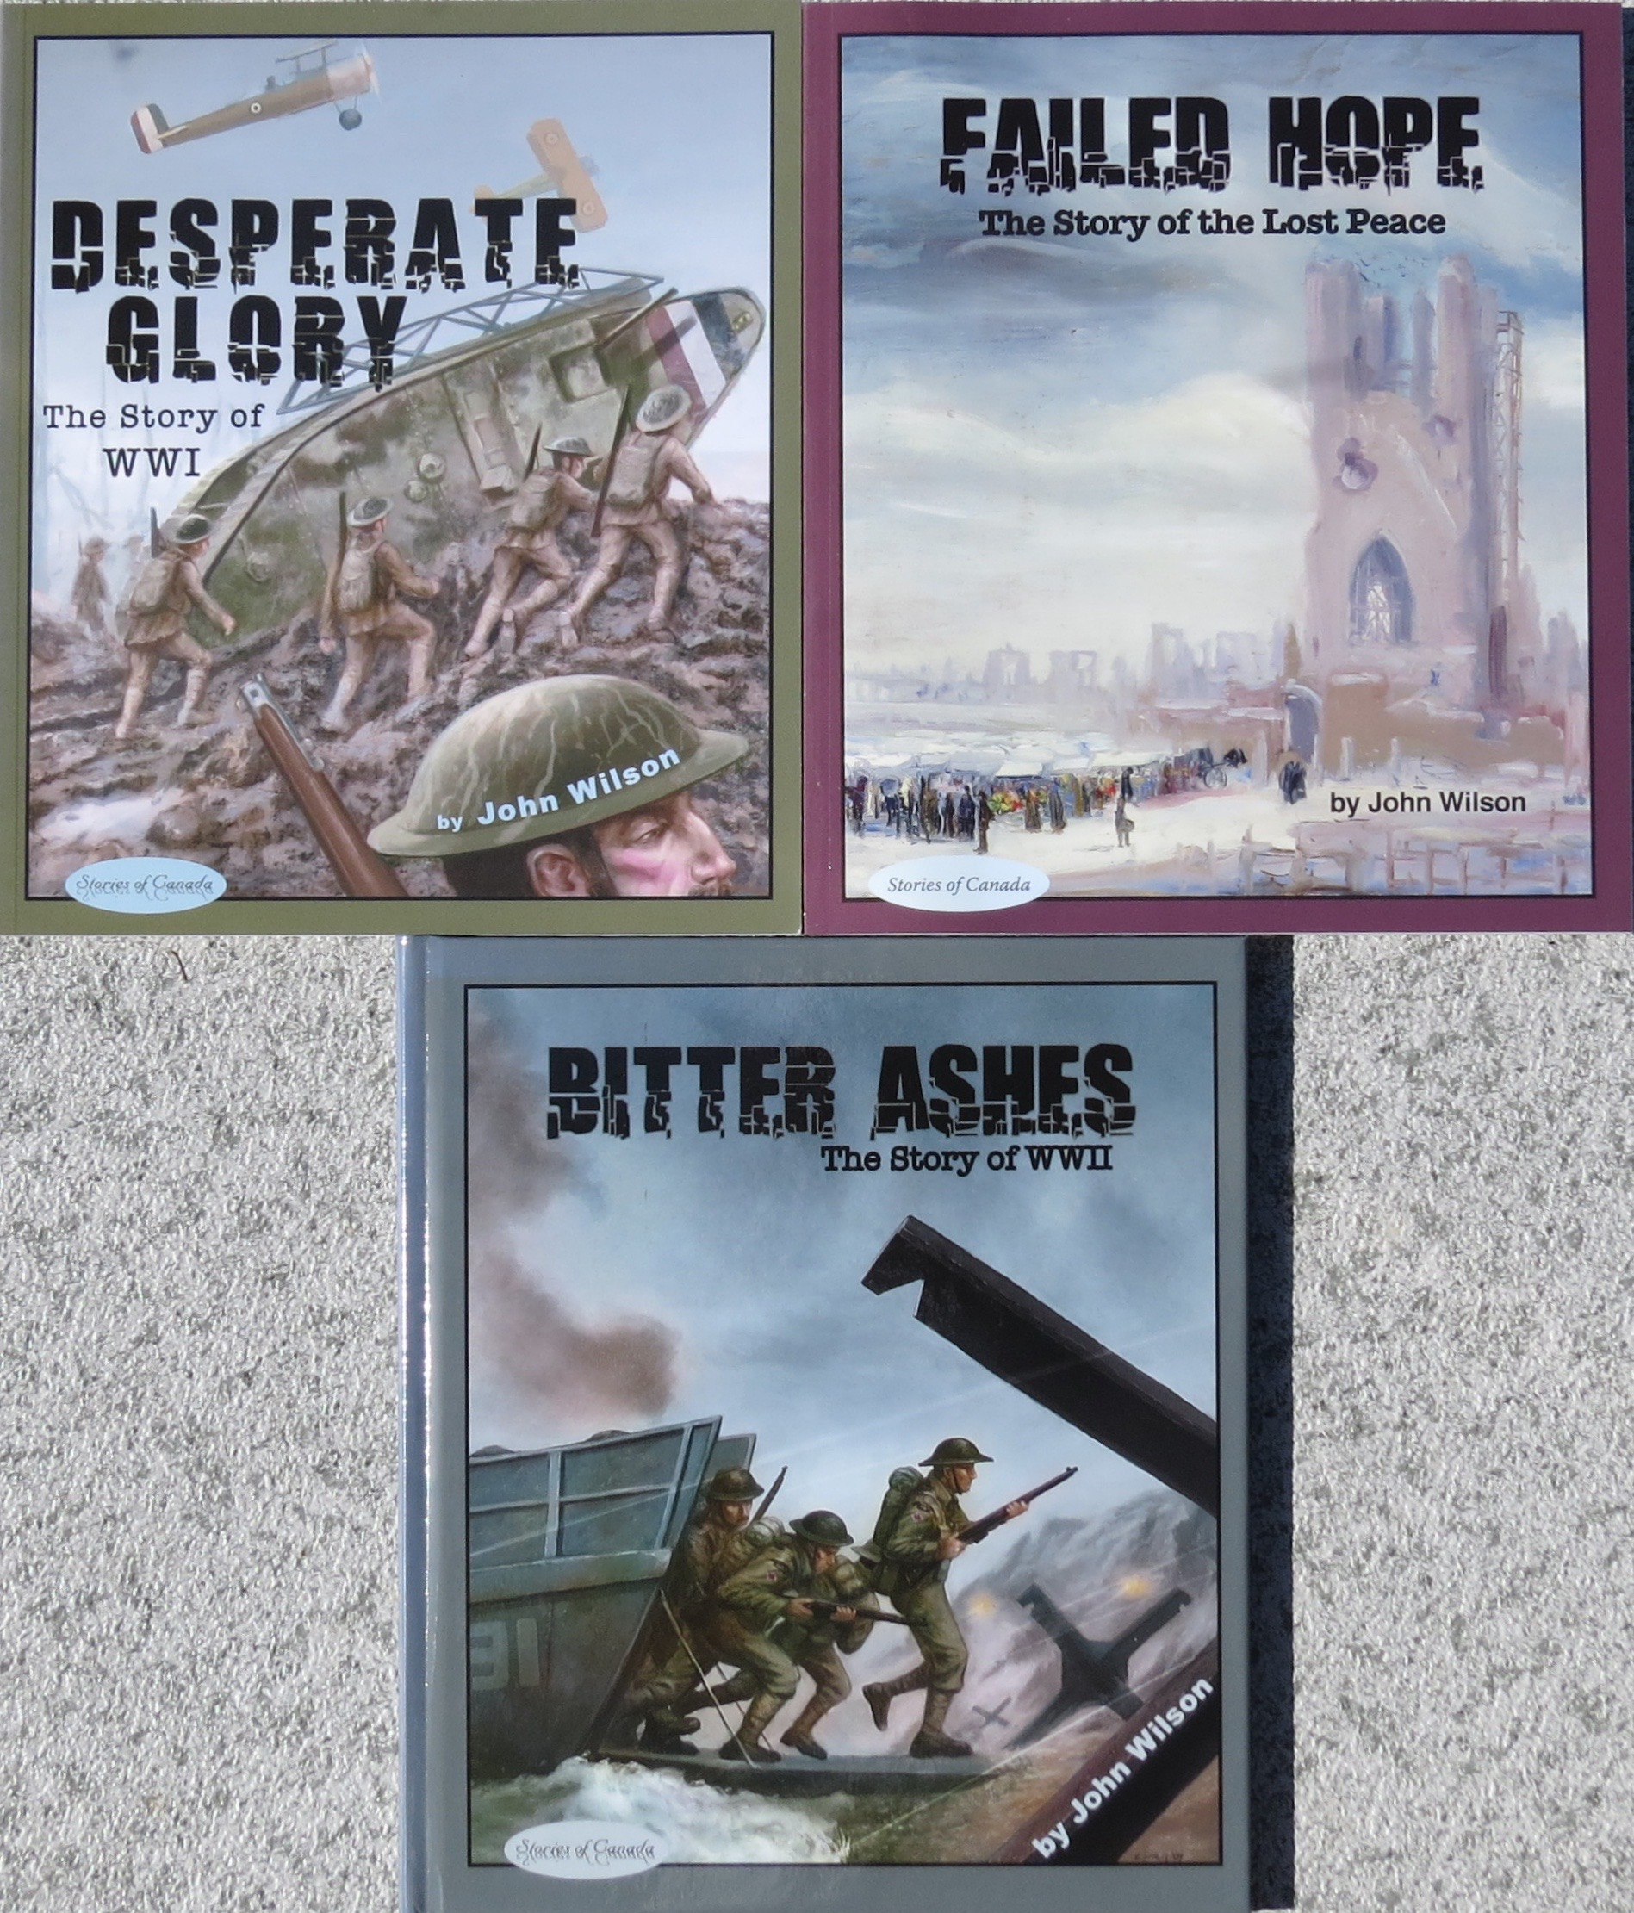
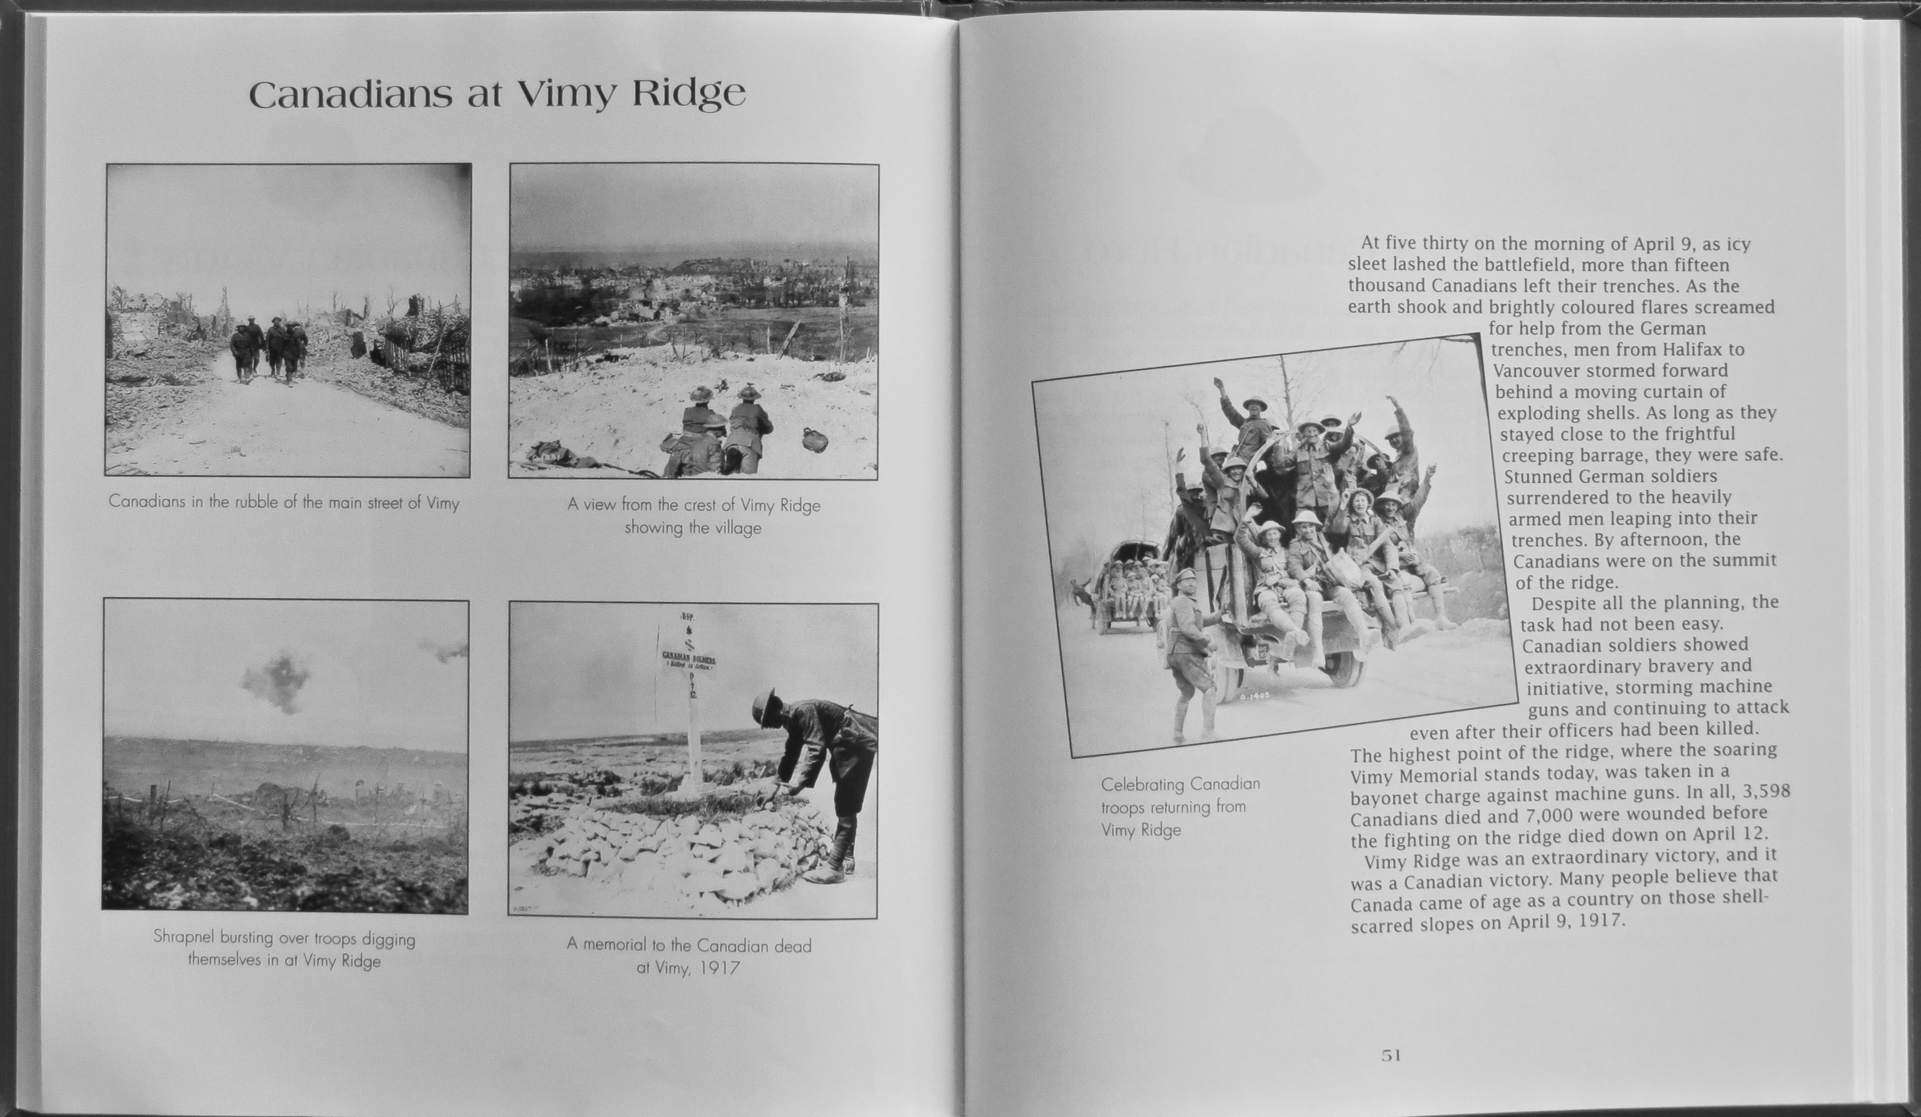

Slide 18
Resources
Fiction

Slide 19
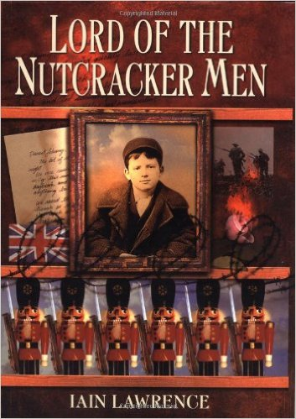

Slide 20
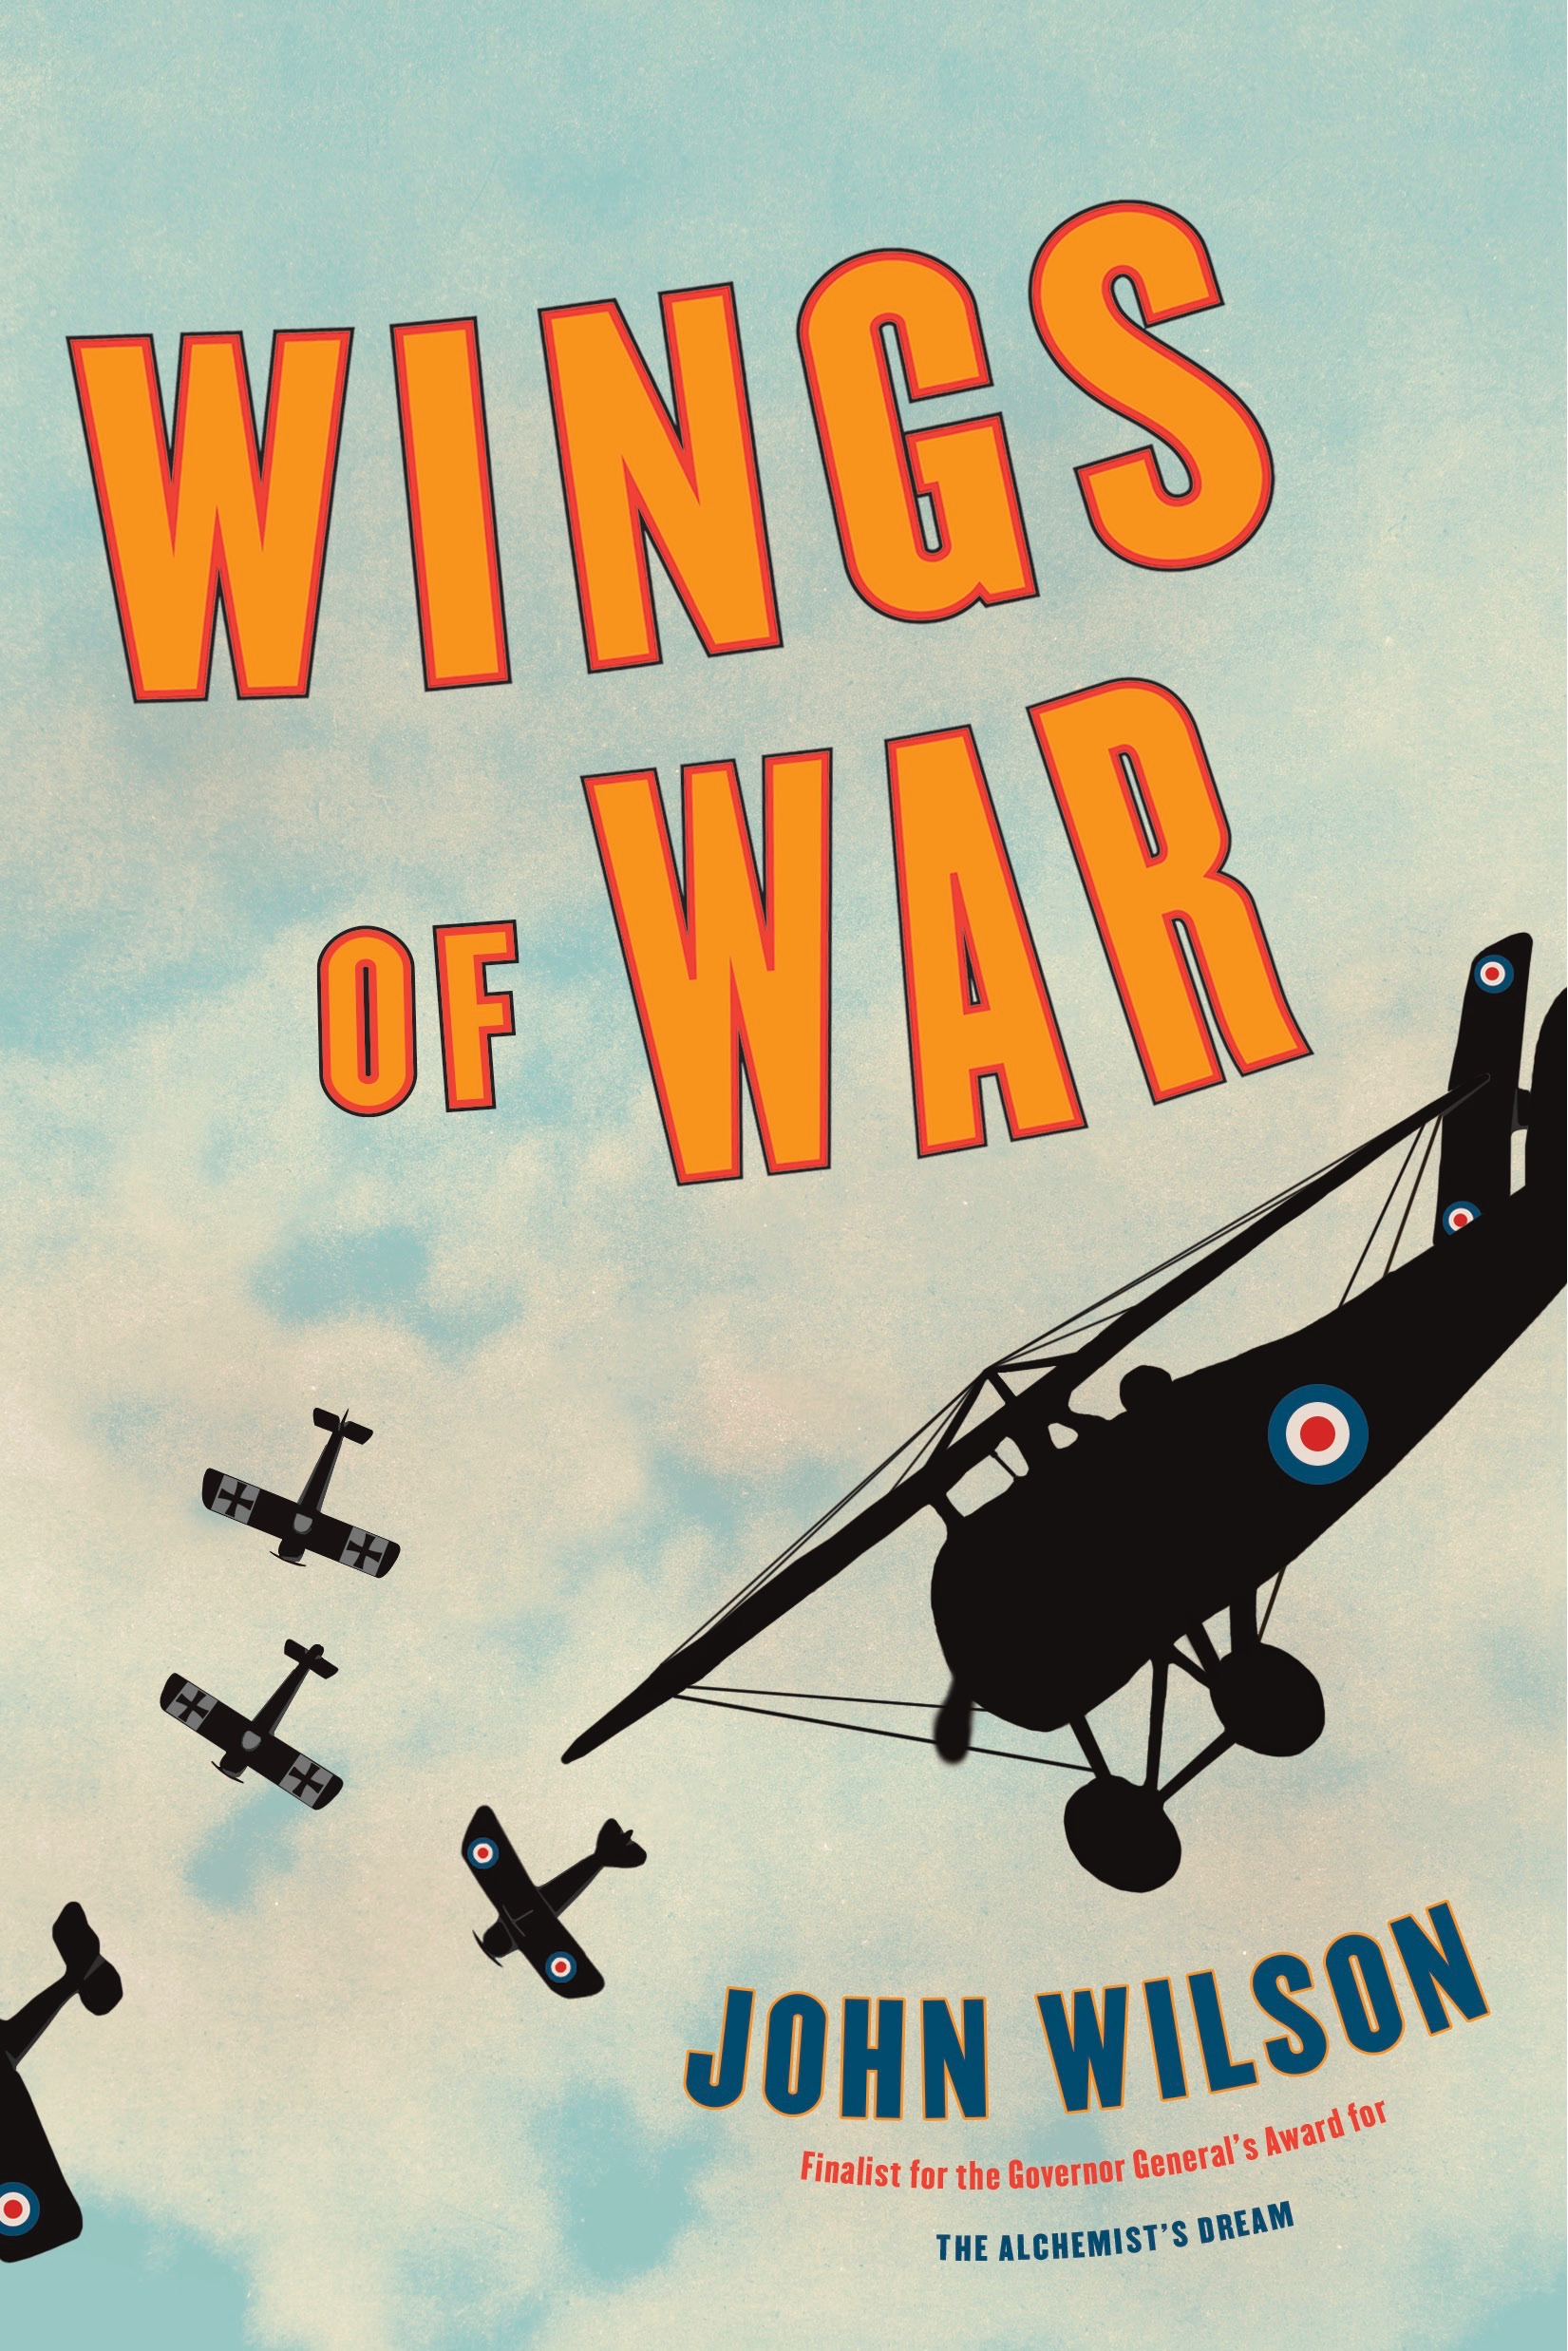

Slide 21
A Soldier’s Life

Slide 22
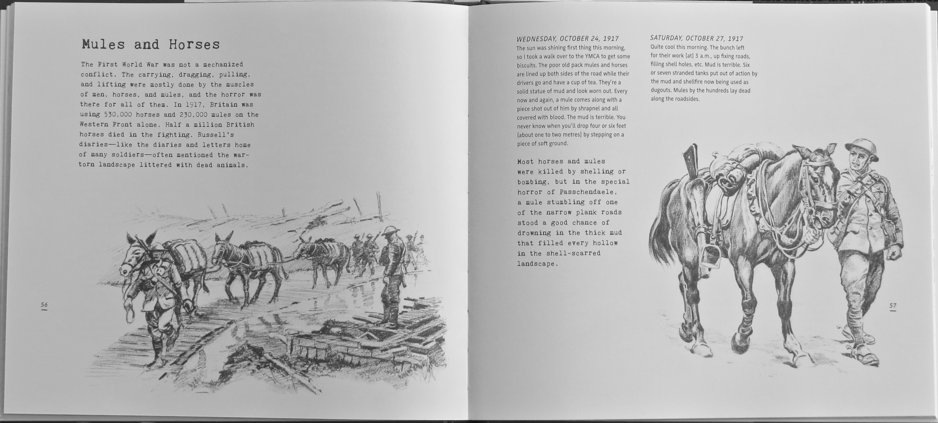

Slide 23
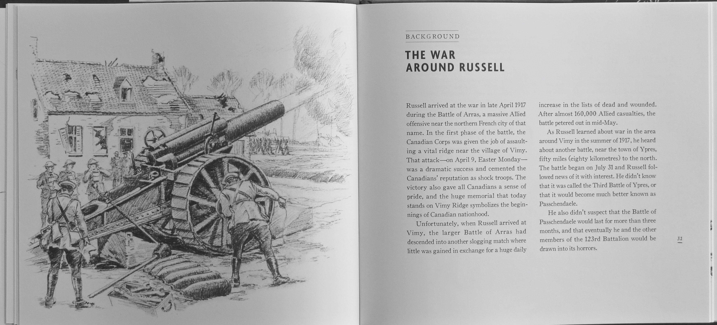

Slide 24
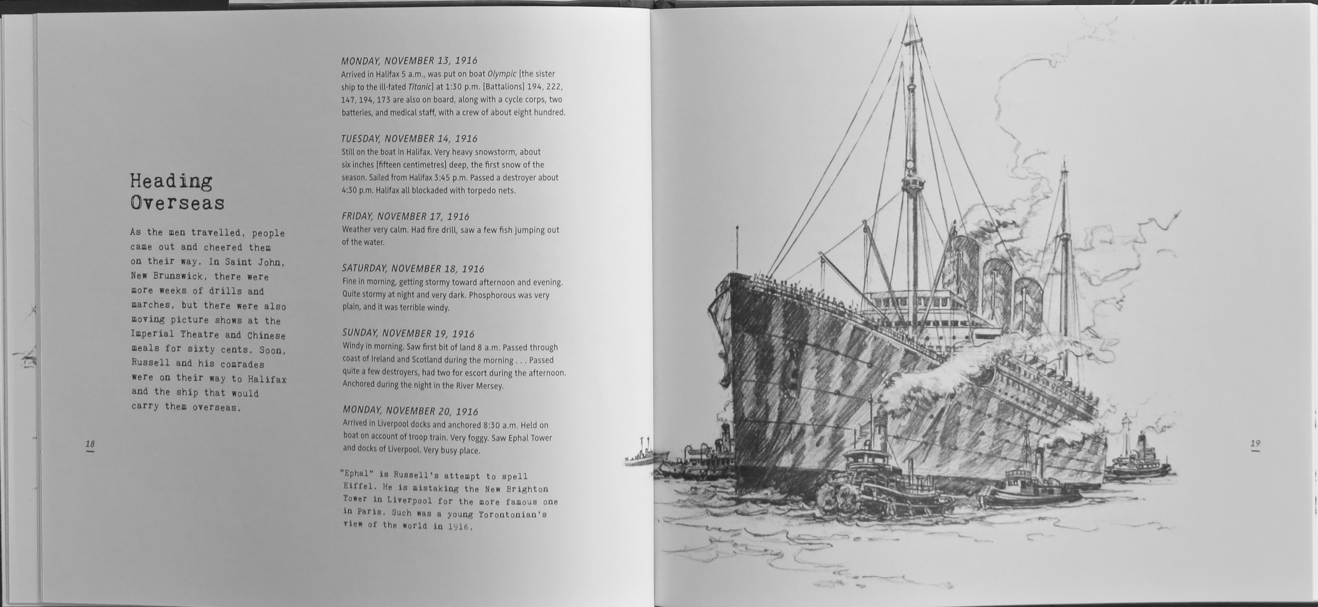
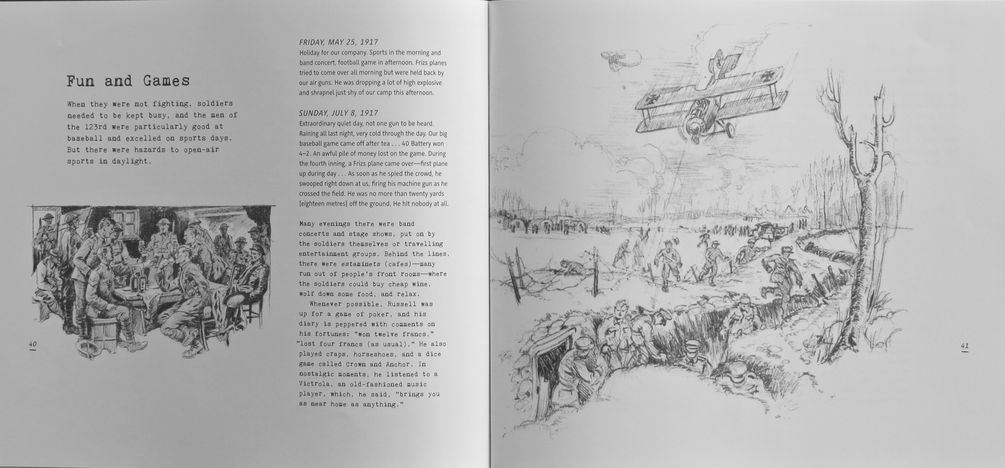
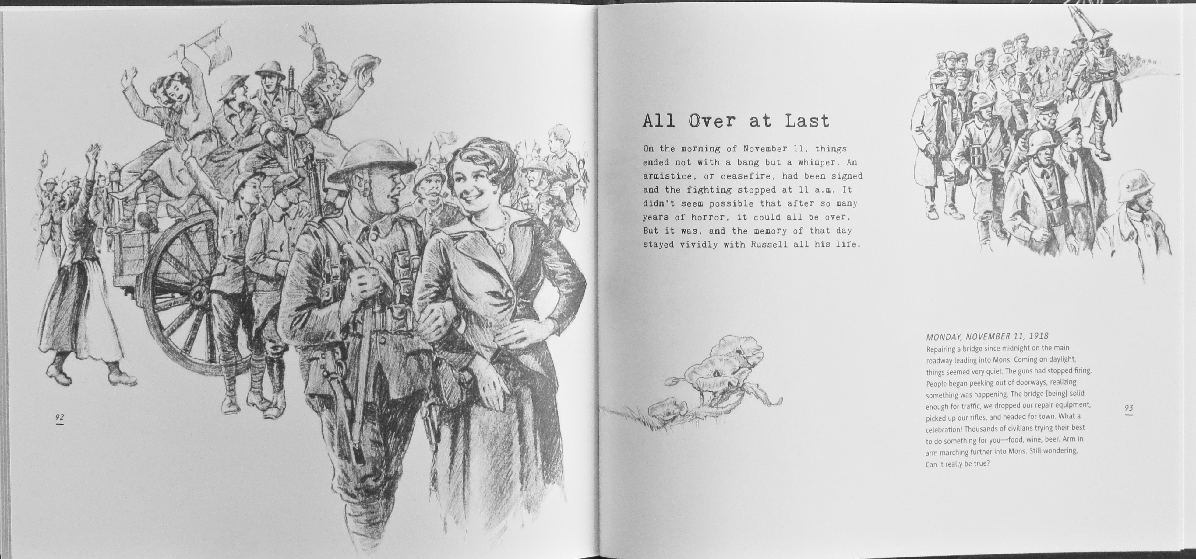

Slide 25
Handout

Slide 26
Vimy Resources
WWI Non-Fiction
WWI Fiction
John Wilson’s WWI Books

Slide 27
John Wilson’s Website: www.johnwilsonauthor.com
Vimy Resources
At Vimy Ridge, Hugh Brewster, Scholastic, 2007, 48 pages.
Valour at Vimy Ridge, Tom Douglas, Amazing Stories, 2007, 144 pages.
The Vimy Oaks, Linda Granfield, North Winds Press, 2017, 36 pages
Vimy, Pierre Burton, Pen and Sword, 2012, 256 pages.
From Vimy to Victory, Hugh Brewster, Scholastic, 2014, 48 pages.
WWI Non-fiction
The Great War, Robert Livesey and A.G Smith, Fitzhenry & Whiteside, 2006, 90 pages.
The War to End All Wars, Russell Freedman, Clarion Books, 2010, 192 pages.
The War to End All Wars, Jack Batten, Tundra, 2009, 160 pages.
Where Poppies Grow, Linda Granfield, Fitzhenry & Whiteside, 2005, 48 pages.
World War 1 for Kids, Kent Rasmussen, Chicago Review Press, 2014, 192 pages.
Frightful First World War, Terry Deary & Martin Brown, Scholastic, 2008, 144 pages.
Desperate Glory: The Story of WWI, Napoleon, 2008, 96 pages.
A Soldier’s Sketchbook: The Illustrated First World War Diary of R. H. Rabjohn, Tundra, 2017, 120 pages.
WWI Fiction
Charlie Wilcox, Sharon McKay, Puffin, 2011, 304 pages.
Lord of the Nutcracker Men, Iain Lawrence, HarperCollins, 2004, 272 pages.
Megiddo’s Shadow, Arthur Slade, HarperCollins, 2006, 368 pages.
All Quiet on the Western Front, Erich Maria Remarque, Ballantine, 1987, 304 pages.
Generals Die in Bed, Charles Yale Harrison, Annick, 2014, 176 pages.
Proud as a Peacock, Brave as a Lion, Jane Barclay, Tundra, 2009, 24 pages.
A Bear in War, Stephanie Innes & Harry Endrulat, Pajama Press, 2012, 40 pages.
Forget-Me-Not, Maxine Trottier, Tuckamore, 2008, 32 pages
First World War Books by John Wilson
And in the Morning, Heritage House, 2014, 220 pages.
Shot at Dawn, Scholastic, 2011, 202 pages.
Wings of War: Tales of War Book I, Doubleday, 2014, 182 pages.
Dark Terror: Tales of War Book II, Doubleday, 2015, 200 pages.
A Dangerous Game: Tales of War Book III, Doubleday, 2016, 196 pages.
Red Goodwin, Ronsdale Press, Vancouver, 2006, 170 pages.
A Soldier’s Sketchbook: The Illustrated First World War Diary of R. H. Rabjohn, Tundra, 2017, 120 pages.
Desperate Glory: The Story of WWI, Napoleon, Toronto, 2008, 96 pages.
http://www.warmuseum.ca/firstworldwar/
http://www.veterans.gc.ca/eng/remembrance/history/first-world-war
http://ww1.canada.com
http://www.thecanadianencyclopedia.ca/en/article/first-world-war-wwi/
https://www.collectionscanada.gc.ca/firstworldwar/index-e.html
http://www.thememoryproject.com/stories/WWI

